Slide 1


BASICS OF GIT AND GITHUB

Slide 2

HELLO!
I am Chinmay Mahagaonkar
I am just a fellow programmer who loves to share codes :)
You can find me at chinmaymahagaonkar@gmail.com

Slide 3
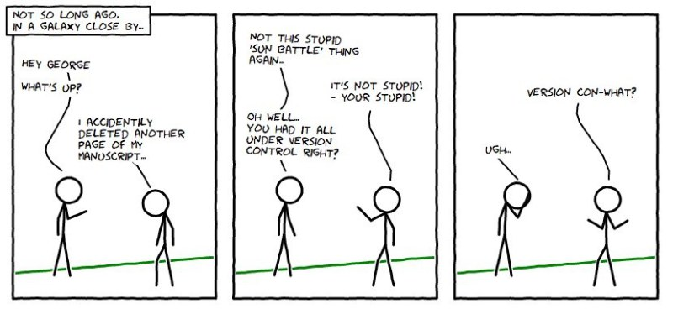

Slide 4
LET’S START WITH BASICS FIRST…
How do you work with other developers?
Work in a team, probably on particular components ?
Integrate your code together.
Make copies of your files in case something you lose them. (Not really?)

Slide 5

WHAT’S VERSION CONTROL?
Version control is the management of changes to documents, primarily computer programs.
Also known as revision control or source control.
Examples: git, mercurial, subversion

Slide 6
WHY VERSION CONTROL?
Makes working in a team easy!
Code without interference.
Go back to a previous version (iOS 10 anyone?)
Integrate code of multiple developer’s easily.
Know who did what, when.
Keep your code secure.

Slide 7
GIT
1
WHAT’S THE BIG DEAL ABOUT THIS ANYWAY?

Slide 8
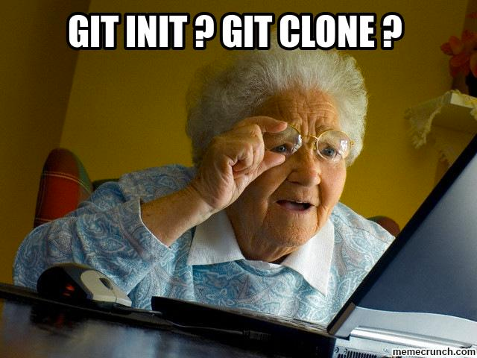

HERE’S SOMETHING ABOUT GIT
A distributed version control system
Command-Line Tool (accessible with Terminal on the Mac or Git Bash on Windows)

Slide 9
VERSION CONTROL TERMINOLOGY
Version control system (VCS) or (SCM)
Repository
Commit
Sha
Working directory
Checkout
Staging area/index
Branch

Slide 10
LET’S DIVE INTO GOOD STUFF NOW :)
GIT COMMANDS:
(THINGS WE’LL COVER)
Basic git commands
Remote repository – push & pull
Branching, tagging and merging
Let’s GIT’IT Done!

Slide 11
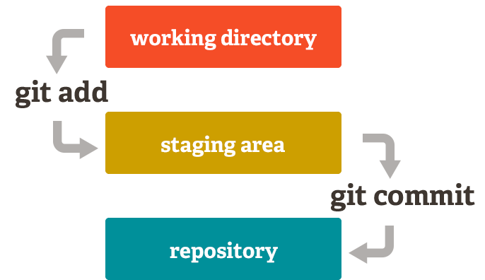

Slide 12
BASIC GIT COMMANDS
git init –
git status –
git add <filename> / git add .
git commit / git commit –m “commit message”
git push
git pull
git clone
Other commands like git show, git ignore, git diff etc.

Slide 13
GITHUB
2
YEAH RIGHT !....LIKE GIT
WASN’T GOOD ENOUGH….

Slide 14
It’s a hosting medium/website for your Git repositories
Offers powerful collaborative abilities
A good indicator of what you code/how much you code/quality of your code

Slide 15
WORKING WITH A REMOTE REPOSITORY
Remote?
It’s the place where your code is stored.
By default, remote name is origin and default branch is master.
Certain things that come to play, namely collaboration.
How are we going to handle that with Git.
So here comes, push, pull, branching, merging, forking.

Slide 16
DEMO

Slide 17
WHAT WE DID SO FAR
CLONE
ADD
COMMIT
PUSH

Slide 18


Dwight

Slide 19

Kevin
Dwight

Slide 20
Dwight
Kevin
Oscar

Slide 21


Kevin
Dwight
Oscar
CONFLICT ERROR

Slide 22
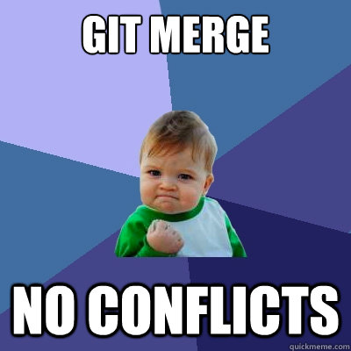
MORE ON COLLABORATIVE GIT COMMANDS
Deleting a branch
git branch –d <branchname>
Merge conflicts! How do you resolve?
Pull requests ?
git tag –a v1.0 / git tag –a v1.0 <commit sha>

Slide 23
MORE TO LEARN IN GIT, FORWARD STEPS

Slide 24
THANKS!
Any questions?
CREDITS
Presentation: Chinmay Mahagaonkar
Moderator: Trupti Parate
Organizers: Whole team of Atomic Loops

